Slide 1
Design and Analysis of Algorithms
Algorithms-II : CS345A
Lecture 21
Shortest paths
in presence of negative weights
Dynamic Programming – (Final lecture)

Slide 2
RECAP of the Last Lecture

Slide 3








The execution of Bellman Ford algorithm
Like a wave …☺
$$n−1$$
This visualization should help you design the algorithm on your own
in case you forget it ever in future ☺
$$n−2$$
$$i$$
$$i−1$$
$$1$$
Paths with edges $≤i$
All paths from $s$
Paths with edges$≤i−1$

Slide 4
Bellman-Ford algorithm
Bellman-Ford-algo($s$,$G$)
{
For each $v∈V\backslash \{s\}$ do
If $(s,v)∈E$ then $L[v,1]$← ?
else $L[v,1]$← ?
$L[s,1]$← ?
For $i$ = $2$ to $n−1$ do
{ For each $v∈V$ do
$L[v,i]$←$L[v,i−1]$;
For each $(x,v)∈E$ do
$L[v,i]\text{←}$ min( ? , ? )
}
}
$ω\left(s,v\right)$
$∞$;
Initializing $L[∗,1]$
$0$;
{
Computing$L[v,i]$
$$L[v,i]$$
$L[x,i−1]+ω\left(x,v\right)$
}
Lemma: $L[v,i]$ stores the shortest path from $s$to $v$ having at most $i$ edges.

Slide 5
shortest paths in a graph
Having Negative weight cycle

Slide 6
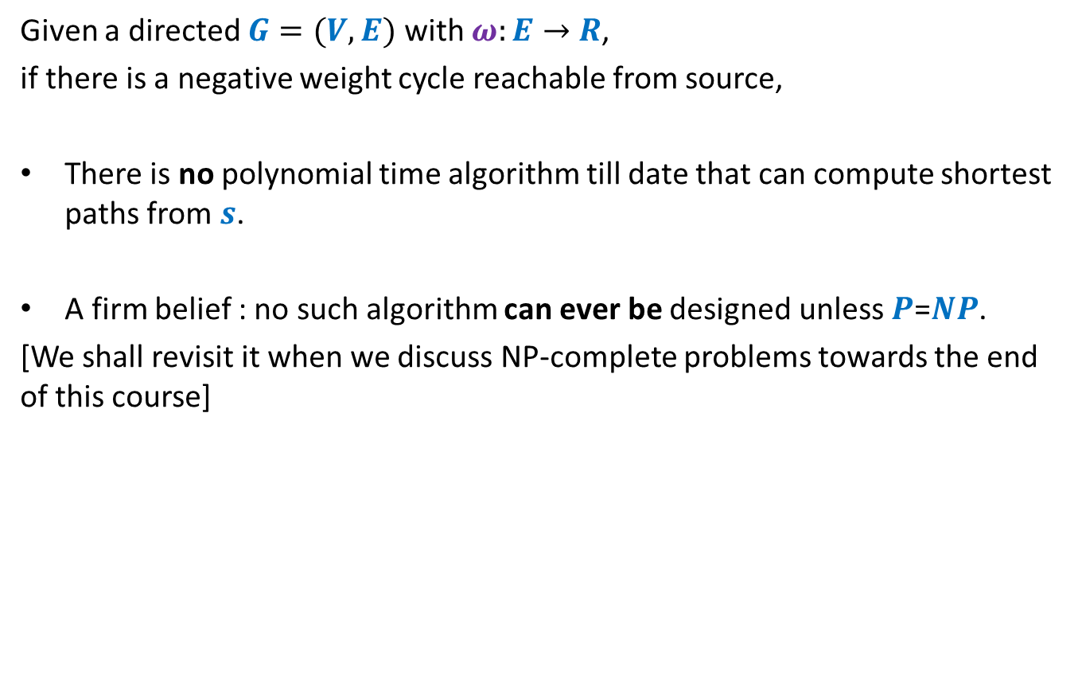
Shortest paths in presence of negative weight cycles
Given a directed $G=(V,E)$ with $ω:E→$ $R$,
if there is a negative weight cycle reachable from source,
There is no polynomial time algorithm till date that can compute shortest paths from $s$.
A firm belief : no such algorithm can ever be designed unless $P$=$NP$.
[We shall revisit it when we discuss NP-complete problems towards the end of this course]

Slide 7
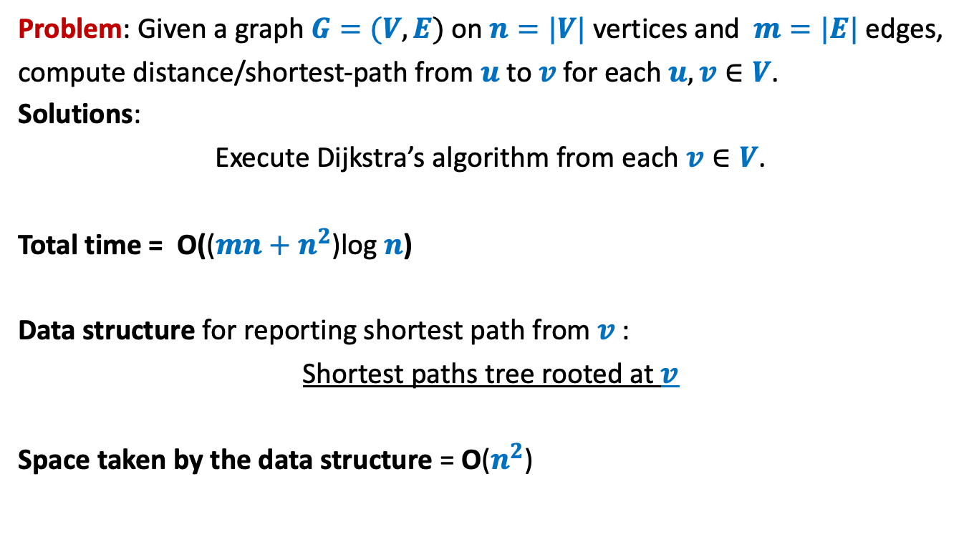
All-pairs shortest paths in a graph with positive edge weights
Problem: Given a graph $G=(V,E)$ on $n=|V|$ vertices and $m=|E|$ edges,
compute distance/shortest-path from $u$ to $v$for each $u,v∈V$.
Solutions:
Execute Dijkstra’s algorithm from each $v∈V$.
Total time = O(($mn+n^{2}$)log $n$)
Data structure for reporting shortest path from $v$ :
Shortest paths tree rooted at $v$
Space taken by the data structure = O($n^{2}$)

Slide 8

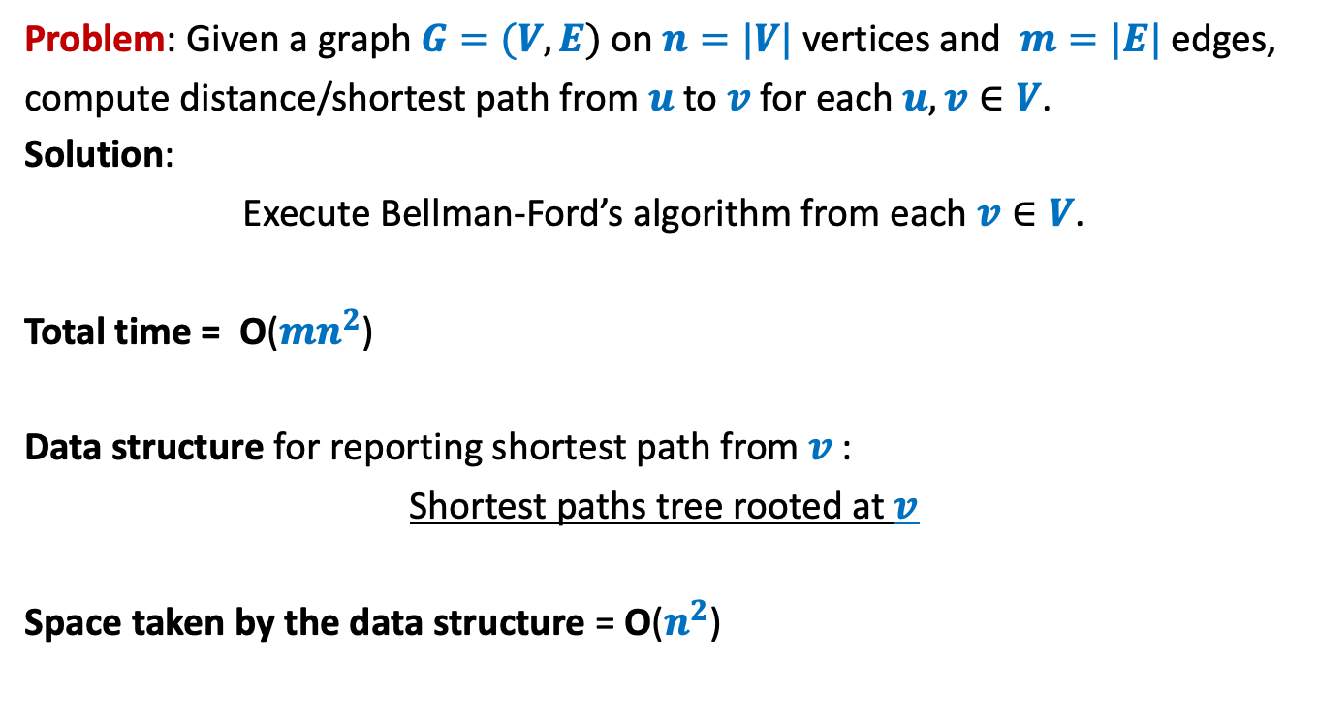
All-pairs shortest paths in a graph with negative edge weights but no negative cycle
Problem: Given a graph $G=(V,E)$ on $n=|V|$ vertices and $m=|E|$ edges,
compute distance/shortest path from $u$ to $v$for each $u,v∈V$.
Solution:
Execute Bellman-Ford’s algorithm from each $v∈V$.
Total time = O($mn^{2}$)
Data structure for reporting shortest path from $v$ :
Shortest paths tree rooted at $v$
Space taken by the data structure = O($n^{2}$)
How to improve it to O($n^{3}$) ?

Slide 9

All-pairs shortest paths in O($n^{3}$) time
In graphs with negative edge weights
but no negative cycle
Assume that vertices are numbered from $1$ to $n$ (instead of $0$ to $n−1$)

Slide 10






The Optimal subpath property
Consider any shortest path $P(u,v)$.
We used “no. of edges” for a recursive formulation of $δ(s,v)$. [Bellman Ford algo]
$L(v,i)$ : length of the shortest $s⇝v$ having at most $i$ edges.
$δ(s,v)$ =$L(v,n−1)$
Expressed $L(v,i+1)$ recursvely in terms of $L(x,i)$ for all ($x,v$) $∈E$
Base case: $L(v,1)$ = $ω(s,v)$ if ($s,v$) $∈E$, and $∞$ otherwise.
$i$edges
$$u$$
$$x$$
$v$
$i−1$edges

Slide 11

The Optimal subpath property
Consider any shortest path $P(u,v)$.
$L(v,i)$ : length of the shortest $s⇝v$ having at most $i$ edges.
$δ(s,v)$ =$L(v,n−1)$
$i$edges
$$u$$
$$x$$
$v$
$i−1$edges

Slide 12

The Optimal subpath property
Consider any shortest path $P(u,v)$.
Question: Can we use “vertices” for recursive formulation of $δ(u,v)$ ?
$$u$$
$v$

Slide 13










The Optimal subpath property
Consider any shortest path $P(u,v)$.
For a recursive formulation of $δ(u,v)$,
We can use max-index of intermediate vertices on $P(u,v)$.
$$24$$
$$11$$
$$3$$
$$35$$
$$9$$
$$17$$
$$19$$
$$u$$
$v$
?
max-index
?
<$35$
<$35$

Slide 14

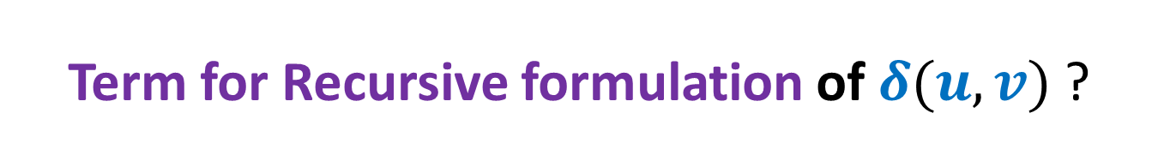


Term for Recursive formulation of $δ(u,v)$ ?
: the shortest path from $i$ to $j$with intermediate vertices of index $≤k$
$D_{k}(i,j)$: length of $P_{k}(i,j)$.
Question: How can we express $δ(i,j)$ in terms of $D_{k}(i,j)$?
Answer: $δ(i,j)$ = $D_{n}(i,j)$:
Base Case:
$D_{0}(i,j)$ = ?
Question: What is recursive formulation of $D_{k}(i,j)$ ?
$$P_{k}(i,j)$$
$$\left\{\begin{aligned}ω\left(i,j\right) if (i,j)∈E \\ ∞ otherwise\end{aligned}\right.$$

Slide 15




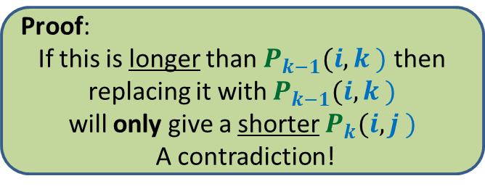




Recursive formulation of $D_{k}(i,j)$
Consider the path $P_{k}(i,j)$
There are two cases:
Case 1 : $P_{k}(i,j)$ does not pass through $k$
Case 2 : $P_{k}(i,j)$ indeed passes through $k$
➔ $D_{k}(i,j)$ = $D_{k−1}(i,j)$
➔ $?$
$$k$$
$$i$$
$j$
?
$P_{k−1}(i,k)$
Proof:
If this is longer than $P_{k−1}(i,k )$ then
replacing it with $P_{k−1}(i,k )$
will only give a shorter $P_{k}(i,j )$
A contradiction!

Slide 16

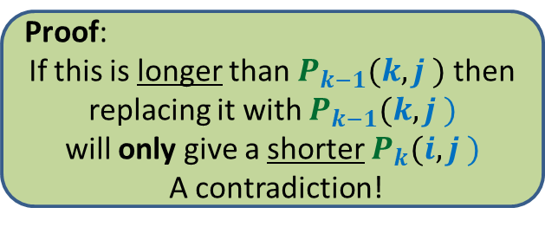
Recursive formulation of $D_{k}(i,j)$
Consider the path $P_{k}(i,j)$
There are two cases:
Case 1 : $P_{k}(i,j)$ does not pass through $k$
Case 2 : $P_{k}(i,j)$ indeed passes through $k$
➔ $D_{k}(i,j)$ = $D_{k−1}(i,j)$
➔ $?$
$$k$$
$$i$$
$j$
?
?
$P_{k−1}(i,k)$
$P_{k−1}(k,j)$
Proof:
If this is longer than $P_{k−1}(k,j )$ then
replacing it with $P_{k−1}(k,j )$
will only give a shorter $P_{k}(i,j )$
A contradiction!

Slide 17
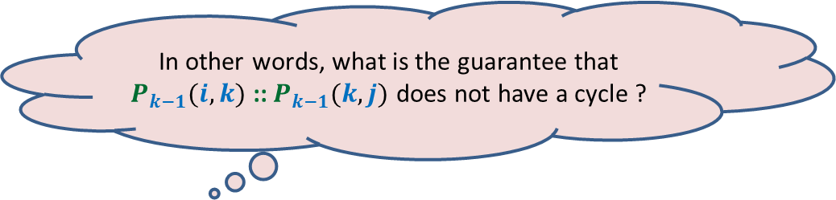


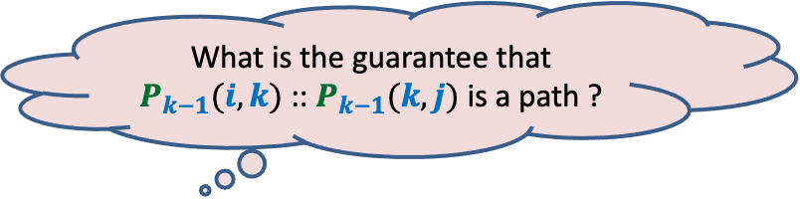
Recursive formulation of $D_{k}(i,j)$
Consider the path $P_{k}(i,j)$
There are two cases:
Case 1 : $P_{k}(i,j)$ does not pass through $k$
Case 2 : $P_{k}(i,j)$ indeed passes through $k$
➔ $D_{k}(i,j)$ = $D_{k−1}(i,j)$
➔ $?$
$$k$$
$$i$$
$j$
?
?
$P_{k−1}(i,k)$
$P_{k−1}(k,j)$
What is the guarantee that $P_{k−1}(i,k)$ :: $P_{k−1}(k,j)$ is a path ?
In other words, what is the guarantee that $P_{k−1}(i,k)$ :: $P_{k−1}(k,j)$ does not have a cycle ?

Slide 18
Recursive formulation of $D_{k}(i,j)$
Consider the path $P_{k}(i,j)$
There are two cases:
Case 1 : $P_{k}(i,j)$ does not pass through $k$
Case 2 : $P_{k}(i,j)$ indeed passes through $k$
➔ $D_{k}(i,j)$ = $D_{k−1}(i,j)$
➔ $?$
$$k$$
$$i$$
$j$
?
$P_{k−1}(i,k)$
$P_{k−1}(k,j)$

Slide 19


Recursive formulation of $D_{k}(i,j)$
Consider the path $P_{k}(i,j)$
There are two cases:
Case 1 : $P_{k}(i,j)$ does not pass through $k$
Case 2 : $P_{k}(i,j)$ indeed passes through $k$
➔ $D_{k}(i,j)$ = $D_{k−1}(i,j)$
➔ $?$
A Cycle
$$k$$
$$i$$
$j$
?
$P_{k−1}(i,k)$
$P_{k−1}(k,j)$
The cycle passes through $k$.
and its weight must be non-negative.
Can you see a shorter or same length path
which does not pass through $k$.
A contradiction !

Slide 20
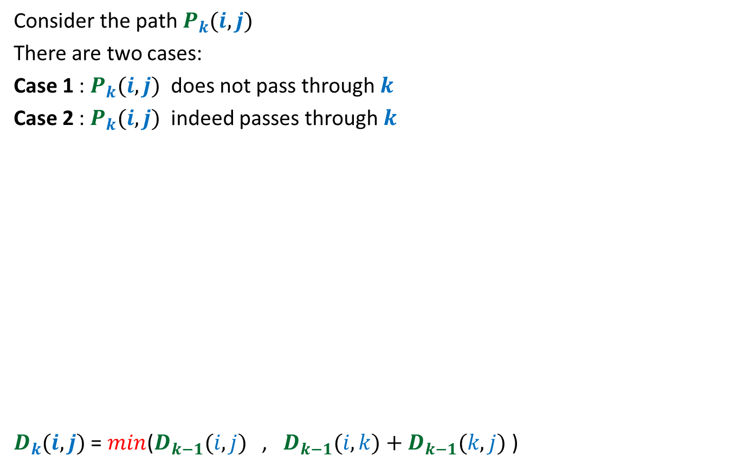
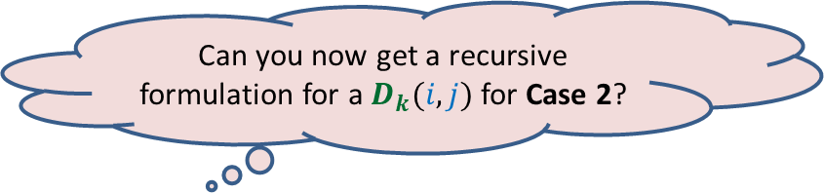


Recursive formulation of $D_{k}(i,j)$
Consider the path $P_{k}(i,j)$
There are two cases:
Case 1 : $P_{k}(i,j)$ does not pass through $k$
Case 2 : $P_{k}(i,j)$ indeed passes through $k$
$D_{k}(i,j)$ = $min$($D_{k−1}(i,j)$ , $D_{k−1}(i,k)+D_{k−1}(k,j)$ )
➔ $D_{k}(i,j)$ = $D_{k−1}(i,j)$
➔ $D_{k}(i,j)$ = $D_{k−1}(i,k)+D_{k−1}(k,j)$
Therefore,
$$k$$
$$i$$
$j$
?
?
$P_{k−1}(i,k)$
$P_{k−1}(k,j)$
Can you now get a recursive formulation for a $D_{k}(i,j)$ for Case 2?
How to get an unconditional expression for $D_{k}(i,j)$ ?

Slide 21

Floyd Warshal Algorithm for All Pairs Shortest Paths
in O($n^{3}$) time
and O($n^{3}$) space

Slide 22










Floyd and Warshal’s algorithm
Floyd-Warshal-algo($G$)
{ For each $i$ do
For each $j$ do
If $(i,j)∈E$ then $D_{0}[i,j]$← ?
else $D_{0}[i,j]$← ?
For each $i$ do $D_{0}[i,i]$← ?
For $k$ = $1$ to $n$ do
For each $i$ do
For each $j$ do
$D_{k}[i,j]$←$D_{k−1}[i,j]$;
$D_{k}[i,j]\text{←}$ min( ? , ? )
}
Lemma: $D_{k}[i,j]$ = length of the shortest path from $i$ to $j$
with all intermediate vertices of indices $≤k$
$ω\left(i,j\right)$
$∞$;
Computing $D_{0}[∗,∗]$
$0$;
The algorithm uses $n$ Matrices.
Hence ($n^{3}$) space ☹.
Can you reduce it?
Can you manage with single matrix ?
{
Keep only $2$ matrices ☺
Computing$D_{k}[i,j]$
$$D_{k}[i,j]$$
$D_{k−1}[i,k]+$ $D_{k−1}[k,j]$
}

Slide 23

Floyd Warshal Algorithm for All Pairs Shortest Paths
in O($n^{3}$) time
and O($n^{2}$) space

Slide 24










Let us revisit the way we compute $D^{k}$ from $D^{k−1}$
$$D^{k−1}$$
$D_{k}(i,j)$ = $min$($D_{k−1}(i,j)$ , $D_{k−1}(i,k)+D_{k−1}(k,j)$ )
$$k$$
$$D^{k−1}$$
$$i$$
$$D^{k}$$
$$k$$
$$j$$
Which entries of $D^{k−1}$are required
in the computation of $D_{k}(i,j)$ ?

Slide 25

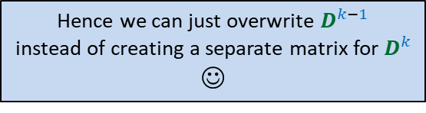




Hence we can just overwrite $D^{k−1}$
instead of creating a separate matrix for $D^{k}$
☺
Let us revisit the way we compute $D^{k}$ from $D^{k−1}$
$$D^{k−1}$$
$D_{k}(i,j)$ = $min$($D_{k−1}(i,j)$ , $D_{k−1}(i,k)+D_{k−1}(k,j)$ )
For any $i≠k,j≠k$, we need …?...
Moreover $D_{k}\left(k,∗\right)=D_{k−1}\left(k,∗\right)$,
$$k$$
$$D^{k−1}$$
$$D^{k}$$
$$k$$
$$i$$
$$j$$
only $k$th column and $k$th row of $D_{k−1}$.
and $D_{k}\left(∗,k\right)=D_{k−1}\left(∗,k\right)$

Slide 26

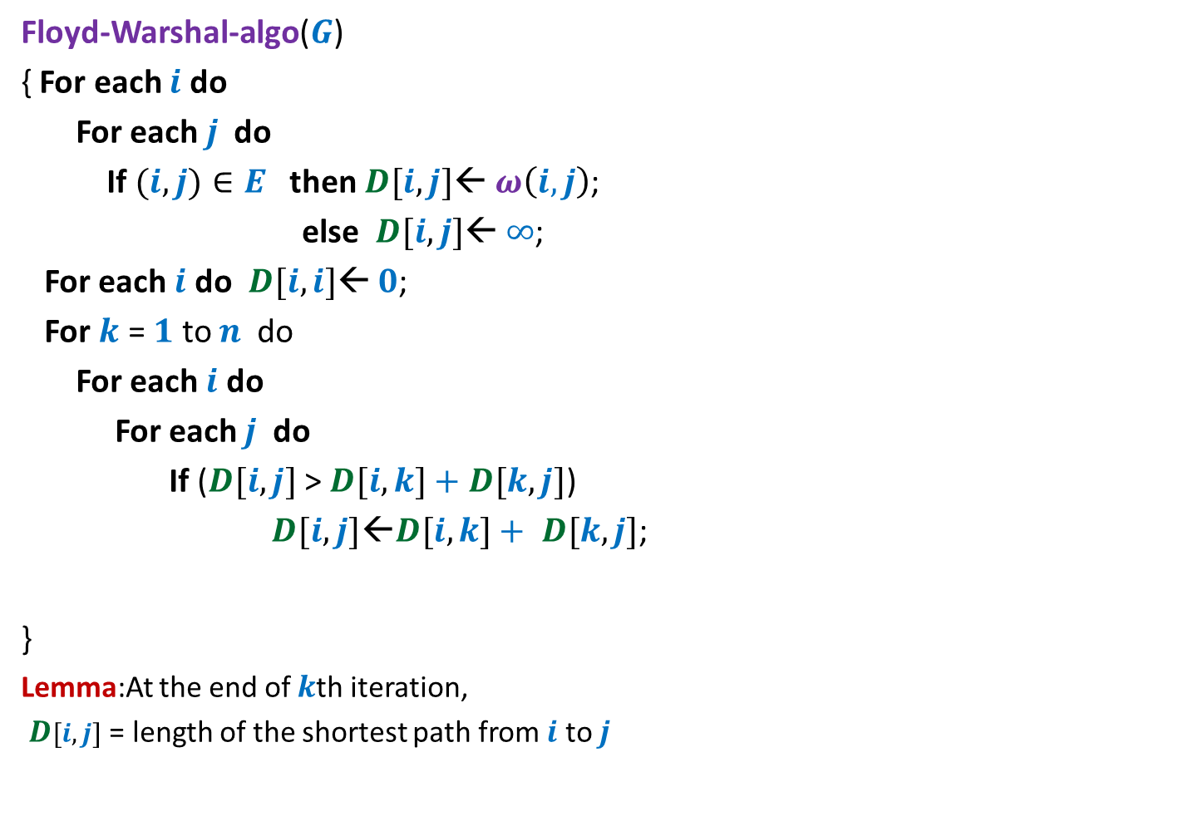
Floyd and Warshal’s algorithm
Floyd-Warshal-algo($G$)
{ For each $i$ do
For each $j$ do
If $(i,j)∈E$ then $D[i,j]$← $ω\left(i,j\right)$;
else $D[i,j]$← $∞$;
For each $i$ do $D[i,i]$← $0$;
For $k$ = $1$ to $n$ do
For each $i$ do
For each $j$ do
If ($D[i,j]$ > $D[i,k]+$ $D[k,j]$)
$D[i,j]\text{←}D[i,k]+ D[k,j]$;
}
Lemma:At the end of $k$th iteration,
$D[i,j]$ = length of the shortest path from $i$ to $j$
{
}
with all intermediate vertices of indices $≤k$

Slide 27
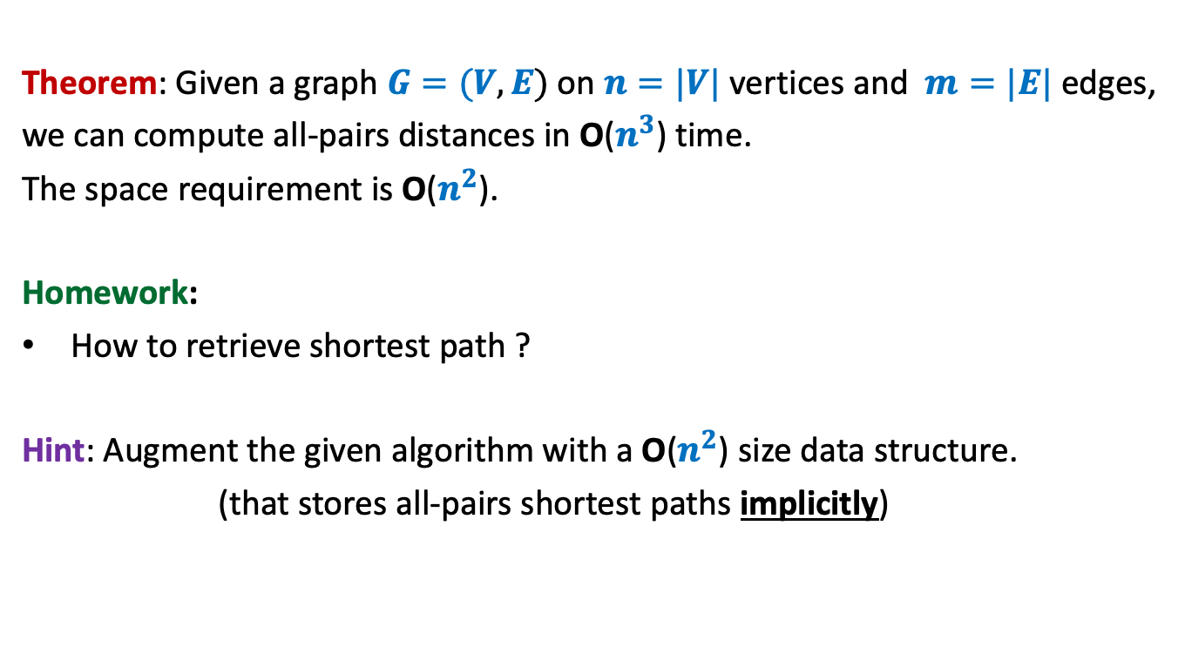
All-pairs shortest paths in a digraph with negative edge weights but no negative cycle
Theorem: Given a graph $G=(V,E)$ on $n=|V|$ vertices and $m=|E|$ edges,
we can compute all-pairs distances in O($n^{3}$) time.
The space requirement is O($n^{2}$).
Homework:
How to retrieve shortest path ?
Hint: Augment the given algorithm with a O($n^{2}$) size data structure.
(that stores all-pairs shortest paths implicitly)

Slide 28
Bellman-Ford algorithm
Bellman-Ford-algo($s$,$G$)
{
For each $v∈V\backslash \{s\}$ do
If $(s,v)∈E$ then $L[v,1]$← ?
else $L[v,1]$← ?
$L[s,1]$← ?
For $i$ = $2$ to $n−1$ do
{ For each $v∈V$ do
$L[v,i]$←$L[v,i−1]$;
For each $(x,v)∈E$ do
$L[v,i]\text{←}$ min( ? , ? )
}
}
$ω\left(s,v\right)$
$∞$;
$0$;
Can we clean this pseudocode as well ?
{
$$L[v,i]$$
$L[x,i−1]+ω\left(x,v\right)$
}
Lemma: $L\left[v,i\right] =$ length of the shortest path from $s$to $v$ having at most $i$ edges.

Slide 29






Bellman-Ford algorithm
Bellman-Ford-algo($s$,$G$)
{
For each $v∈V\backslash \{s\}$ do
$L[v]$←
$L[s]$← ?
For $i$ = $1$ to $n−1$ do
{ For each $(x,v)∈E$ do
$L[v]\text{←}$ min( ? , ? )
}
}
$∞$;
$0$;
$$L[v]$$
$L[x]+ω\left(x,v\right)$
Lemma: $L\left[v,i\right] =$ length of the shortest path from $s$to $v$ having at most $i$ edges.
$$≤$$

Slide 30
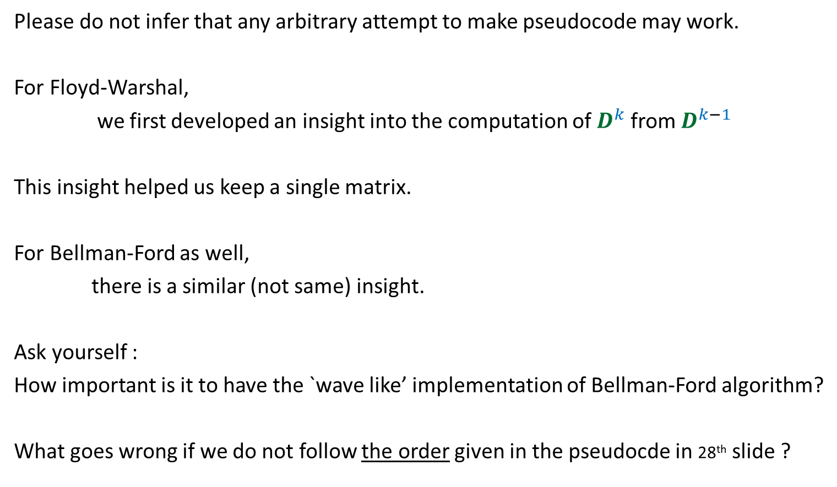
Please do not infer that any arbitrary attempt to make pseudocode may work.
For Floyd-Warshal,
we first developed an insight into the computation of $D^{k}$ from $D^{k−1}$
This insight helped us keep a single matrix.
For Bellman-Ford as well,
there is a similar (not same) insight.
Ask yourself :
How important is it to have the `wave like’ implementation of Bellman-Ford algorithm?
What goes wrong if we do not follow the order given in the pseudocde in 28th slide ?

